Slide 1


CALIPER BRAKE - PAD WEAR WARNING USING INTERNET OF THINGS
Team Members:
S. Aravind Sairam(211616115004)
R. Shadhan(221616115044)
Supervisor:
Dr. M Balakarthikeyan
Associative Professor

Slide 2
AIM
To provide a solution for the pad wear failure of all mechanical brake system using an electronic system which is semi-automatic in nature.

Slide 3
Problem Statement
The downside of the functioning of the existing system is as follows:
The indication given on the dashboard is often ignored by the drivers which leads to the negligence in replacing the worn brake pad
The respective owner of the vehicle is deprived of the information about the brake pad.

Slide 4
Objective:
To improve the consciousness of the user of the vehicle about the condition of the brake pad and to enable the respective owner of the vehicle to be in line with the condition by creating a log for the wear data of the pad for future reference and interpretations.

Slide 5
Methodology Proposed
The objective mentioned can be achieved by incorporating a digital technique in the existing system called IoT (Internet of Things).
The data from the sensor can be uploaded to the server and the warning from the brake pad wear sensor can reach both the driver and the respective owner by a text message.

Slide 6
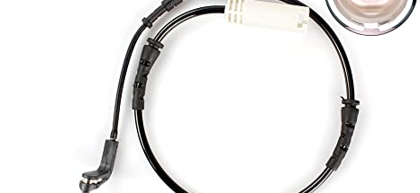
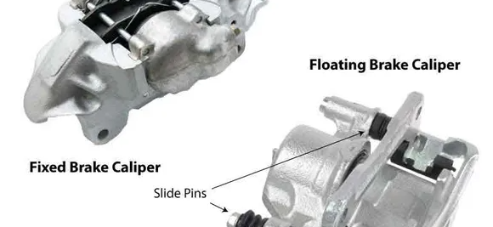
Working of Pad wear Sensor and Caliper Brake
The brake pad wear sensor is used to sense the thickness of the brake pad and is used to indicate the driver when the brake pad wears out above a permissible limit, by glowing a light on the dashboard of the vehicle.

Slide 7
COMPONENTS REQUIRED:
Arduino Uno
Quad Band GPRS GSM Sim 900A
Sim card with Internet (Internet required for data upload to server)
Pad Wear Sensor
9V Battery

Slide 8
Conceptual Block Diagram
GSM
Module
Sim
Card
Text Message
Battery 9v
Arduino
Microcontroller
ThingSpeak
Server
Pad Wear Sensor

Slide 9
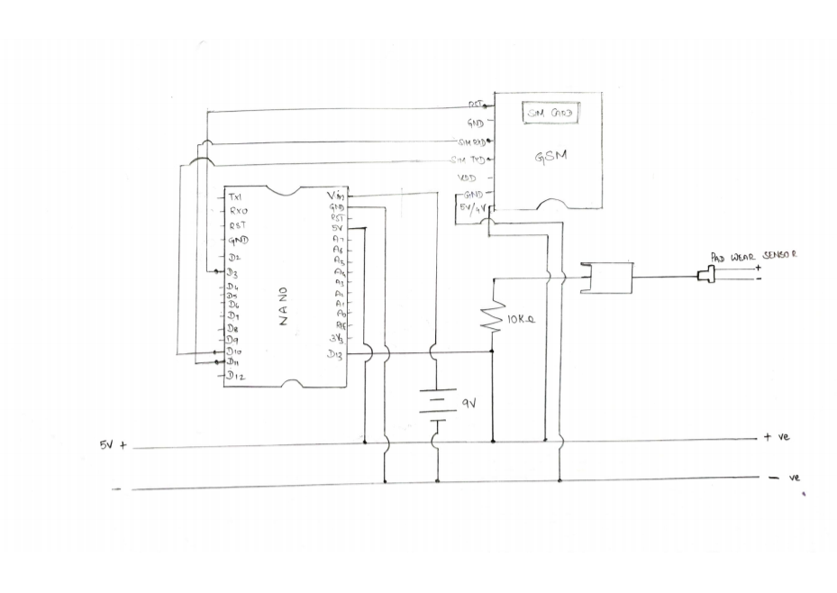

Slide 10
Why GSM Module?
In order to obtain the warning through a long distance, it is reliable to use established networks rather than using Bluetooth with shorter range.
A GSM module has a sim slot through which the sim operator’s network can be used for our purpose.
By using this sim card, we will be able to access internet as well as send SMS to warn the customer.
Internet can be used in order to upload the pad wear in a graphical format to determine the number of stops remaining.

Slide 11
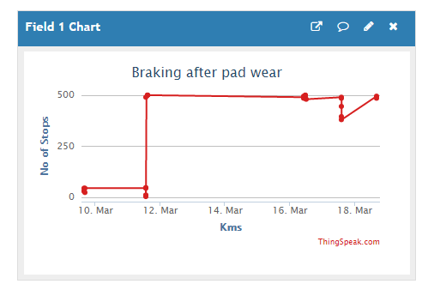
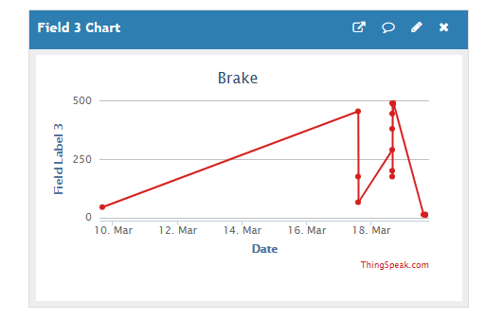
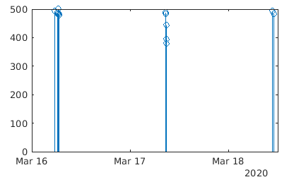
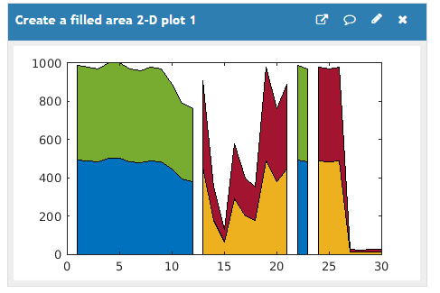
GRAPH using IoT

Slide 12
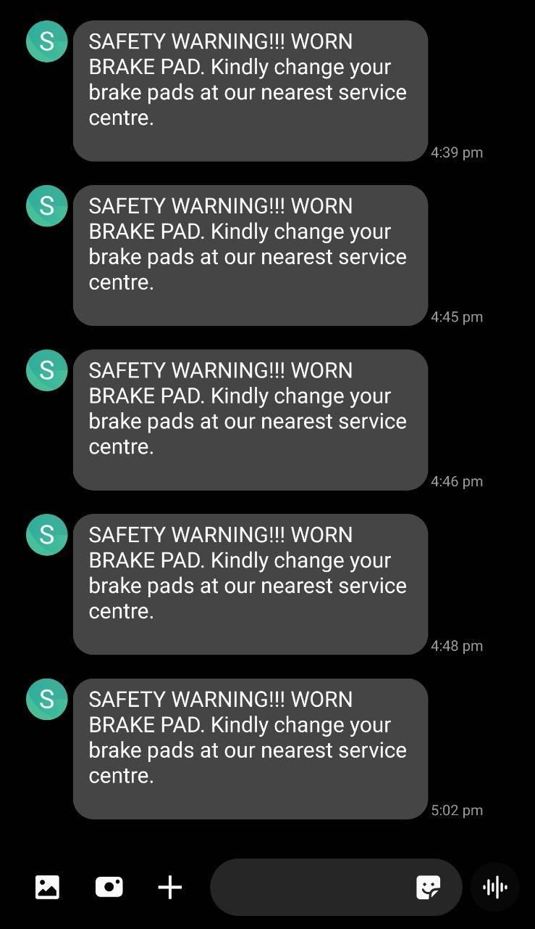
Text Message Warning

Slide 13
RESULT AND CONCLUSION
RESULT:
Whenever there is a sign of brake pad wear, the sensor present on the caliper would detect it and sends the signal to the Arduino.
Using the GSM module, Arduino delivers an SMS to the responsible person warning them to change the brake pad as soon as possible.
The graph is updated using an IoT server (ThingSpeak) which is an open source IoT server.
This server is utilized in order to update the condition of the brake along with the remaining number of stops.

Slide 14
CONCLUSION
Thus, the incorporation of digital and new age techniques such as IoT (Internet of Things) in the brake pad wear warning of reaction beam caliper will assure to deliver the user the facility of real time data monitoring, track the data, analysis of the data provided, and also to have an enhanced control over the monitoring of the vehicle’s performance.

Slide 15
FUTURE SCOPE
The incorporation of the above said digital techniques will be carried out to most of the other braking components required to monitor the braking characteristics and a common control unit will be designed to centralize the working of the components used for monitoring and data transfer.

Slide 16
Way Forward :
We will be able to incorporate most of the vehicle sensors such as temperature sensor, etc., in a single board and the outputs can be viewed for any adjustments.
All the parameters of the vehicle can be obtained and monitored from anywhere using Internet of Things.
An application can be developed to graphically represent the vehicle’s safety parameters that can be understood by anyone.

Slide 17
REFERENCES
David Willey and David G. Williams (1978) ‘Brake pad wear detection system (Patent No: 4204190)
Katsuya Ito and Hitoshi Takanashi (1993) ‘Pad wear and pad wear indicator probe (Patent No: US5608376A)’.
William Gronowicz Jr. (2001) ‘Brake pad wear sensor (Patent No: 6302241)
Daniel Philpott (2014) ‘Brake Pad Wear Monitoring System (Patent No: 20160146279)’.

